Slide 1

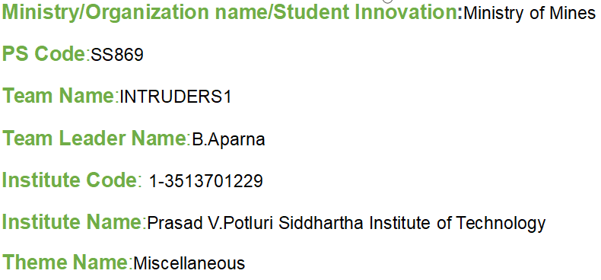
Basic Details of the Team and Problem Statement
Problem Statement Title:
Interpretation of geological,
geochemical and geophysical
dataset using ML/AI to carve
out new mineral potiential areas

Slide 2
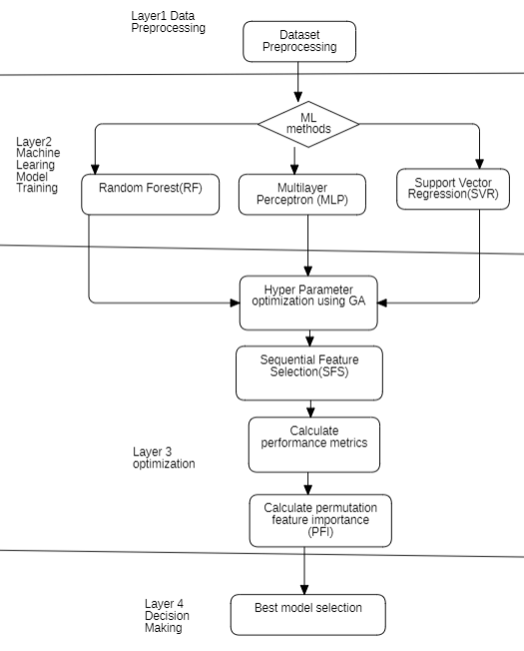
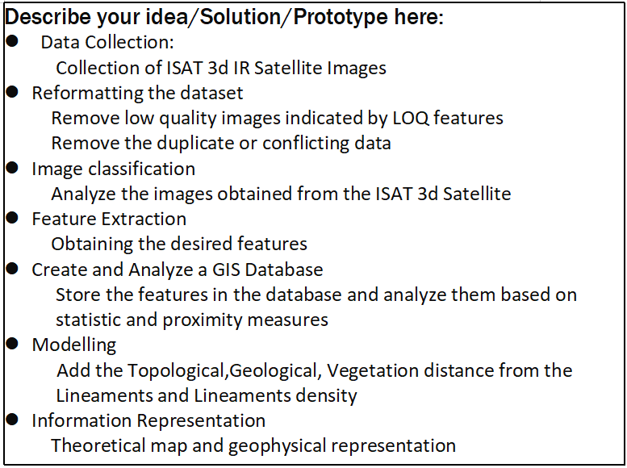
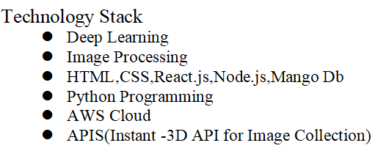
Idea/Approach Details
Flow Chart Diagram

Slide 3
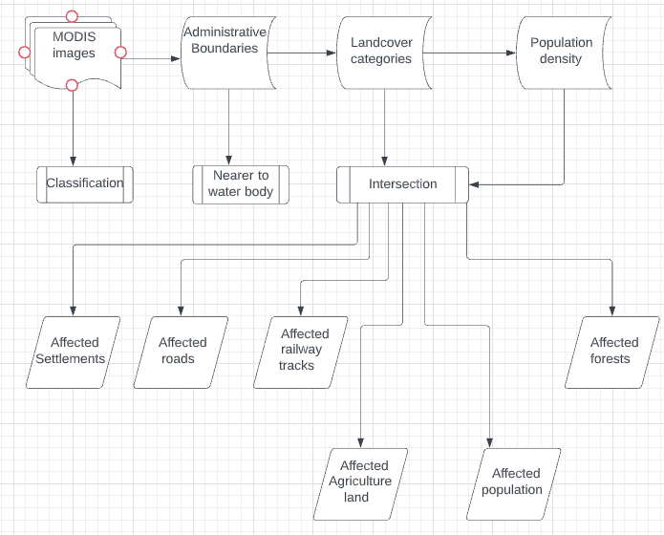
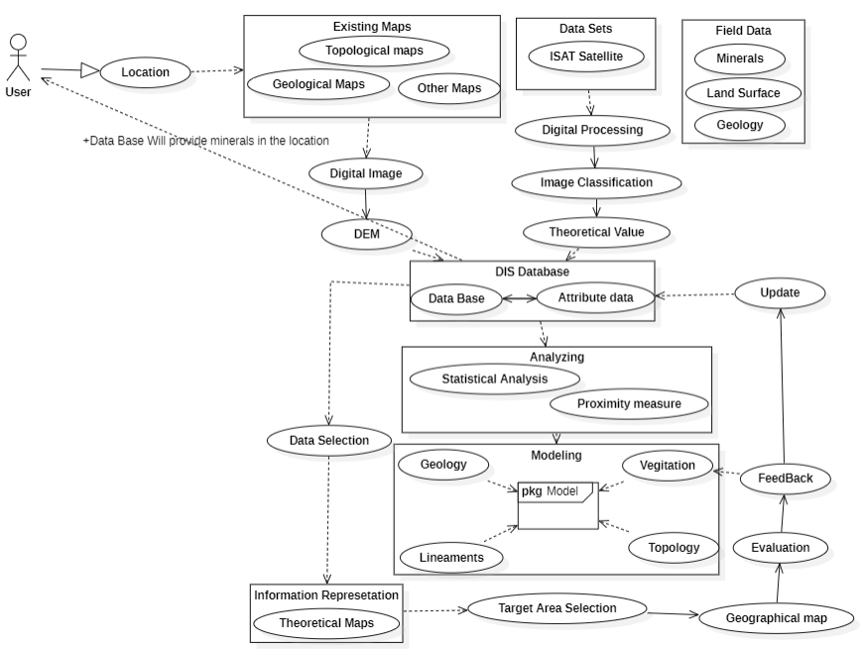
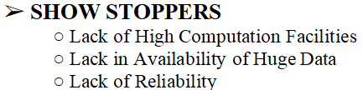
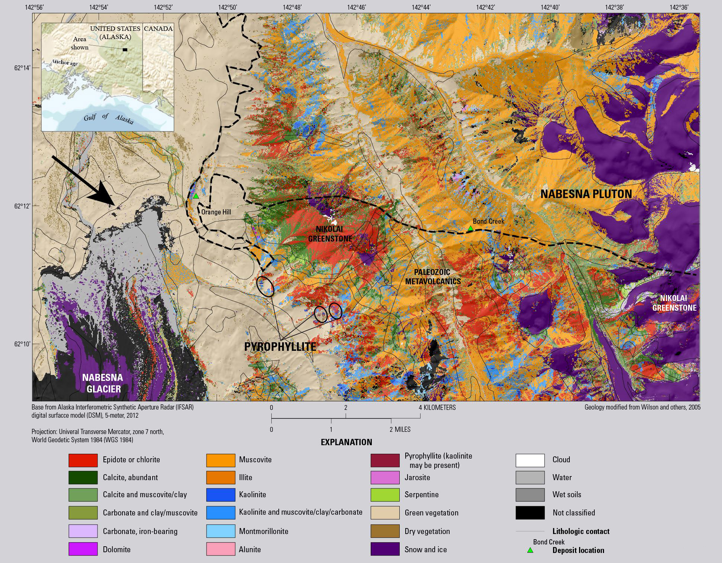
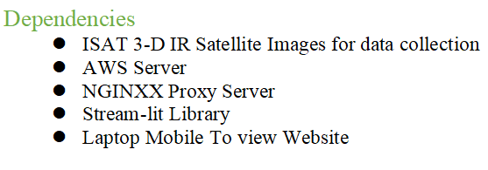
Idea/Approach Details
Sequence Diagram
Describe your Use Cases here
Output

Slide 4
Team Member Details
Team Leader Name: B.Aparna
Branch :Btech Stream :CSE Year :lll
Team Member 1 Name: B.Seetha Ram
Branch :Btech Stream :CSE Year :lll
Team Member 2 Name: CH.Prasanna Chandrika
Branch :Btech Stream :CSE Year :lll
Team Member 3 Name: B.Keerthika
Branch:Btech Stream :CSE Year :lll
Team Member 4 Name: B.Snehitha
Branch:Btech Stream :CSE Year :lll
Team Member 5 Name: G.Naga Harshitha
Branch:Btech Stream:CSE Year :lll
Team Mentor 1 Name: Dr. B. Janakiramaiah
Category (Academic/Industry): Academic Expertise (AI/ML/Blockchain etc): AI,ML,DL Domain Experience (in years): 10
Team Mentor 2 Name: Dr. B. Lakshmi Ramani
Category (Academic/Industry):Academic Expertise (AI/ML/Blockchain etc):AI,ML,DL Domain Experience (in years): 5

